Slide 1

name: Akash Das student code : bwu/bta/21/002 course name : applied digital logic design course code : escm301 PROGRAM NAME : B.TECH CSE (AIML) semester : 3rd section : a topic : carry propagate adder

Slide 2

content
What is carry propagate adder
Block diagram
Truth table and circuit diagram
Reference

Slide 3
WHAT IS CARRY PROPAGATE ADDER To generate a high speed addition requires two types of adder in arithmetic pipeline. 1. Carry propagate adders (CPAs) take some number of inputs and compute a sum by fully propagating the carries. 2. Carry save adders (CSAs) take some number of inputs and produce two redundant outputs, sum and carry. Producing two outputs means the carries do not have to be propagated, an important latency consideration.
N-bit called CPA => adds two numbers such that carries generated in successive digits or propagated.
Each sum bit depends on all previous carries.

Slide 4
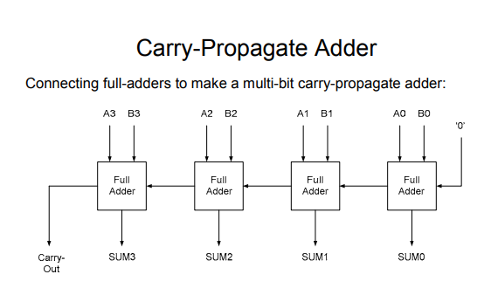
BLOCK DIAGRAM

Slide 5
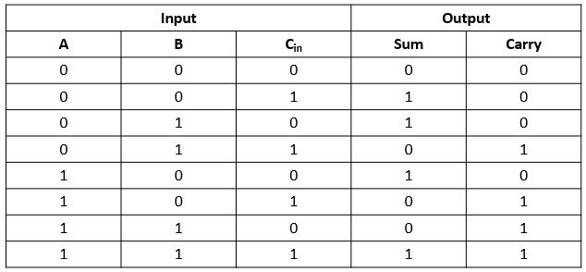
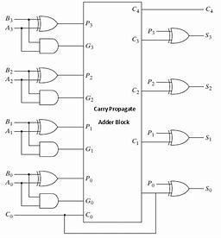
TRUTH TABLE AND CIRCUIT DIAGRAM

Slide 6
REFERENCE
Google
YouTube
Class note

Slide 7
THANK YOU

